Slide 1



PES Institute of Technology, Department of Computer science
MATLAB Based Vehicle Number plate Detection Using OCR
Submitted by
SUDARSHAN R(1475)
PHILIP JOSEPH(1444)
MOHITH SAI(0287)
Guided by
Prof. Chandravva hebbi

Slide 2

Need
2
Smart Parking System Management
Identification of stolen cars or bikes
Smuggling of Cars or bikes
Invalid license plates
Usage of cars in terrorist attacks/illegal activities

Slide 3

AIM
We intended to develop a system in MATLAB which can perform detection as well as recognition of Vehicle License Number plate
The objective of this project is to recognize Vehicle License Number plate using serial communication.

Slide 4

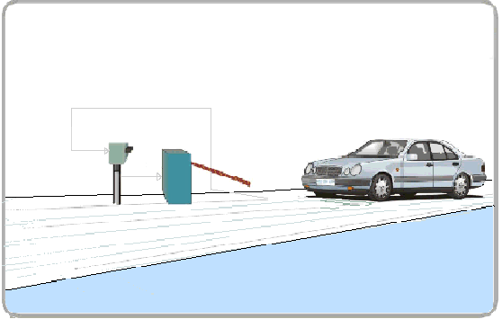
BASIC PROJECT
Input image ( from real environment)
Algorithm using (MATLAB)
Output -Microcontroller serial interfacing with hardware.
12/4/2015 7:53:54
PM

Slide 5

Block Diagram
OCR System
Vehicle
WEB-CAM
Image Acquisition
Localization of Number Plate
Plate Segmentation
Character Recognition
Door Control
Microcontroller
OUTPUT-ASSCII Character
12/4/2015 7:53:54
PM

Slide 6

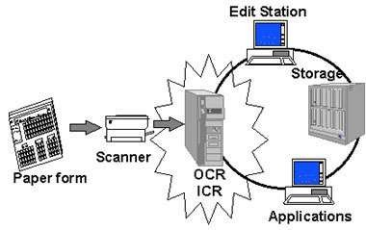
OCR
OCR is a technology that enables you to convert different types of documents captured by a digital camera into editable and searchable data.
Fig. OCR Technology
12/4/2015 7:53:54
PM

Slide 7
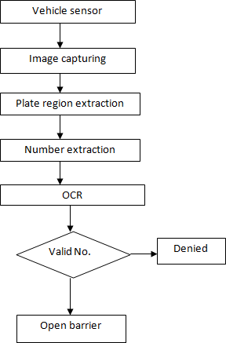
Flow chart

Slide 8
METHODOLOGY: PREWITT METHOD
First the location of the number plate is detected in the entire output image
After that crop the number plate and remove the small objects from the binary image using imcrop() and bwareaopen()
Then process the cropped license plate to display detected number in the image and text format
This is done using the Three m- files code

Slide 9
CODES:
There are three programs or ‘.m’ files for this project.
Template Creation (template_creation.m)– This is used to call the saved images of alphanumerics and then save them as a new template in MATLAB memory.
Letter Detection(Letter_detection.m) – Reads the characters from the input image and find the highest matched corresponding alphanumeric.
Plate Detection(Plate_detection.m) – Process the image and then call the above two m-files to detect the number.

Slide 10
.
1)Template Creation
We have stored the binary images of all the alphabets and numbers in the sub-folder named as ‘alpha'.
Here, in the above code we are saving the images into a variable by using command ‘imread()’. This function is used to call the images from the folder or from any location of the PC into the MATLAB.
Then create a matrix of ‘letter’ and ‘number’ and save it in variable ‘NewTemplates’ by using command ‘save(filename,variables)’.

Slide 11
2)Letter Detection
Here, in the above code we have created a function named letter which gives us the alphanumeric output of the input image from class ‘alpha’ by using command ‘readLetter()’. And then load the saved templates by using command load ‘NewTemplates.
After that, we have resized the input image so it can be compared with the template’s images by using the command ‘imresize(filename,size)’. Then for loop is used to correlates the input image with every image in the template to get the best match.
A matrix ‘rec’ is created to record the value of correlation for each alphanumeric template with the characters template from the input image, as shown in the below code, Then ‘find()’ command is used to find the index which corresponds to the highest matched character. Then according to that index, corresponding character is printed using‘if-else’ statement.

Slide 12
3)Number Plate Detection
Basic commands used in above code are mentioned below:
imread() – This command is used to open the image into the MATLAB from the target folder.
rgb2gray() –This command is used to convert the RGB image into grayscale format.
imbinarize() – This command is used to Binarize 2-D grayscale image or simply we can say it converts the image into black and white format.
edge() – This command is used to detect the edges in the image, by using various methods like Roberts, Sobel, Prewitt and many others.
regionprops() – This command is used to measure properties of image region.
numel() – This command is used to calculate the number of array elements.
.

Slide 13
imcrop() – This command is used to crop the image in the entered size.
bwareaopen() – This command is used to remove small objects from binary image.
By using the above commands in the code, we are calling the input image and converting it into the grayscale. Then the grayscale is converted into the binary image, and the edge of the binary images is detected by the Prewitt method

Slide 14

WORKFLOW
Image was taken from real environment .
Process Digital Images of License Plates using existing/modified
algorithms.
Algorithms will perform alpha numeric conversions on the captured license plate images into text entries.
System would check the extracted entries against a database in real time.
The entire system is implemented in MATLAB is used for detection and
recognition

Slide 15

Basic Modules of the System
 Detection is done by Character Segmentation Locates the alpha numeric characters on a license plate.
 Optical Character Recognition (OCR) Translates the segmented characters into text entries.

Slide 16

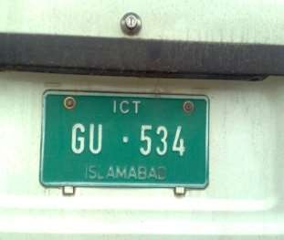
Load The Image From File
 a=imread(‘car 10.JPG’)

Slide 17

Preprocessing
Preprocessing is very important for the performance of character segmentation.
Preprocessing consists of :
Resizing image
Rgb to gray
Noise removal

Slide 18

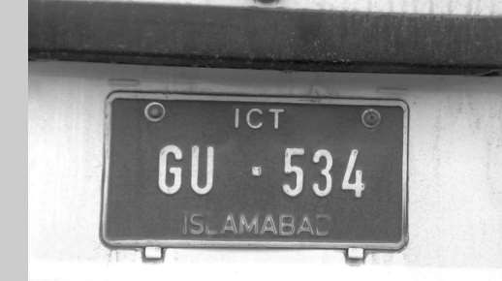
Changing the TYPE
 c=rgb2gray(b);

Slide 19

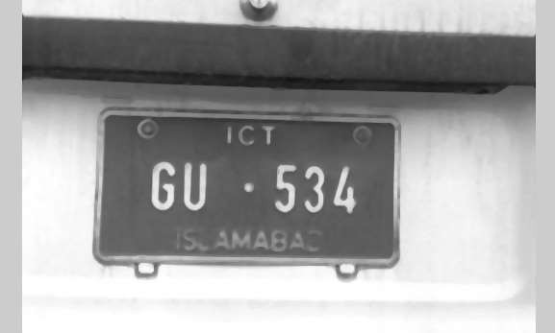
Extracting Plate Region
It is result of dilation after noise removal .

Slide 20

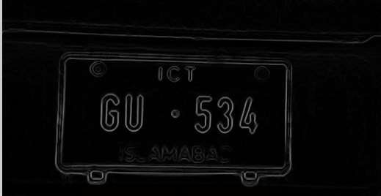
Edge enhancement
gdiff=imsubtract(d,e);
where ‘d’ is dilated and ‘e’ is eroded image

Slide 21

Characters Segmentation
Horizontal & Vertical Segmentation
Detect the horizontal lines in the image with a pixel value of zero.
Converting the image into binary.
Use simple “for loops” to detect the portions of the image that had connected objects with a pixel value of ‘0’ and hence accordingly, the image was read.

Slide 22








Characters Segmentation
Preprocessing
Horizontal And Vertical Segmentation

Slide 23

Characters Recognition
Template Matching
Template matching is one of the most common and easy classification method for recognizing the characters.
We used code for OCR

Slide 24
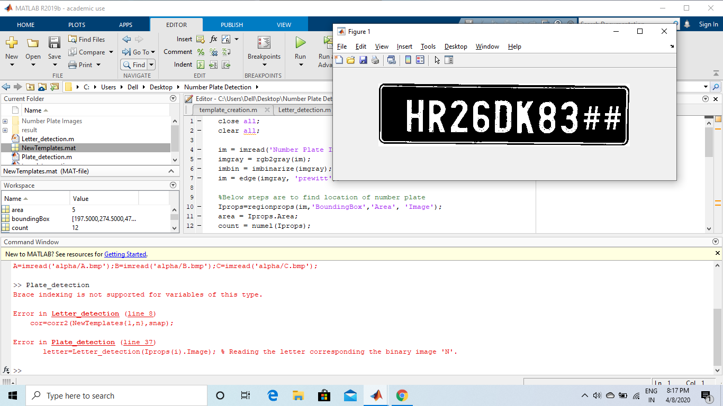

Slide 25
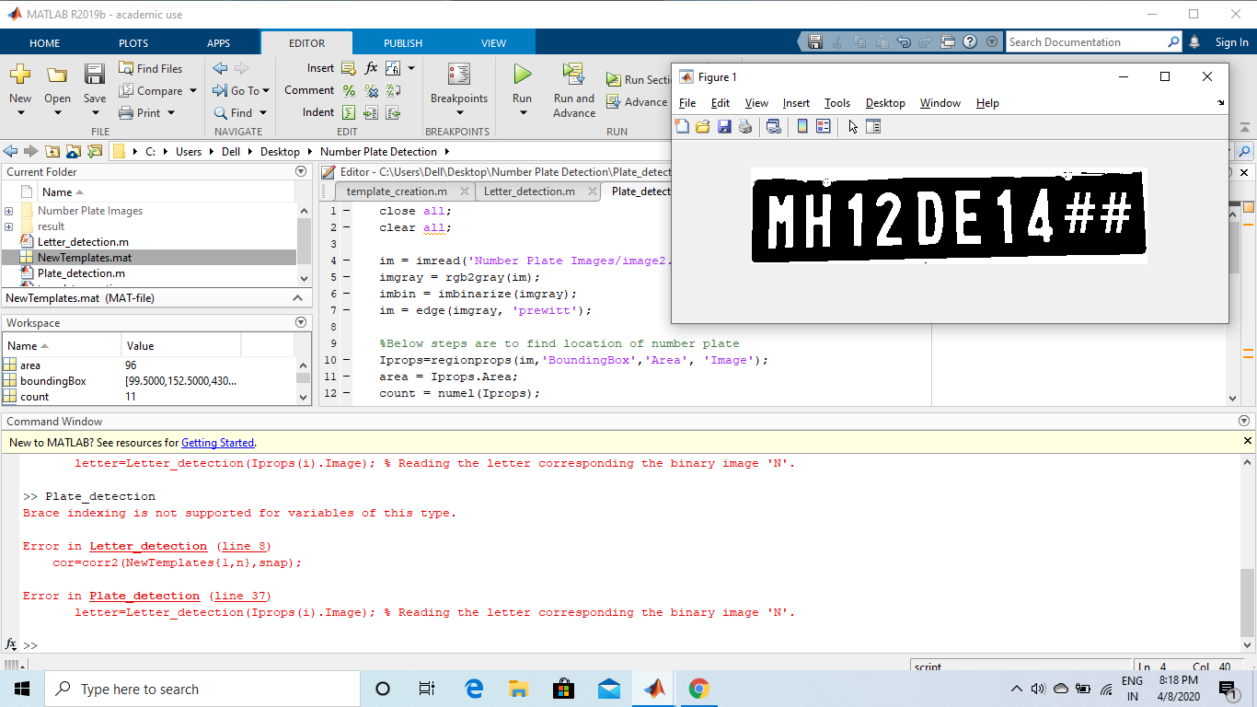

Slide 26

Applications
Red Light Violation Enforcement
Border And Customs Checkpoints
Smart Parking System Management
Detection Of Invalid License Plates

Slide 27

Conclusion
The automatic number plate recognition system using vehicle license plate is presented. The system use image processing techniques for identifying the vehicle from the database stored in the computer.

Slide 28

References
Optical Character Recognition
Ravina Mithe, Supriya Indalkar, Nilam Divekar 2013
International Journal Of Recent Technology And Engineering (Ijrte)
Design Of An Optical Character Recognition System For Camera-Based Handheld Devices
Ayatullah Faruk Mollah, Nabamita Majumder Subhadip Basu, And Mita Nasipuri 2011 International Journal Of Computer Science Issues
Number Plate Recognition Using an Improved Segmentation
Mr. G. T. Sutar , Prof. Mr. A.V. Shah P.G. Student, Department of Electronics Engineering, D.K.T. Engineering College, Ichalkaranji, Maharashtra, India Associate Professor,
Department of Electronics Engineering, D.K.T. Engineering College, Ichalkaranji, Maharashtra
A Review Paper on Automatic Number Plate Recognition (ANPR) System International Journal of Innovative Research in Advanced Engineering (IJIRAE) Volume 1 Issue 1 (April 2014)
THANKS TO PROF.CHANDRAVVA HEBBI MAM

